Slide 1
Long distance coupling between two SRRs
Yutong Zhao
Oct 22nd 2018

Slide 2
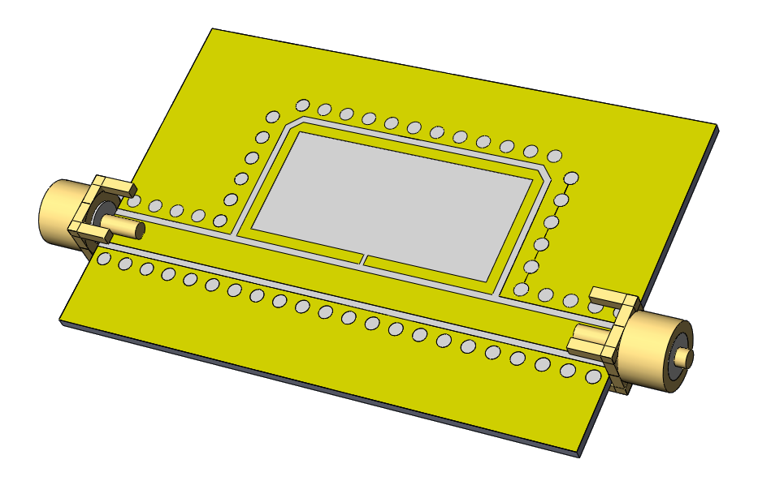
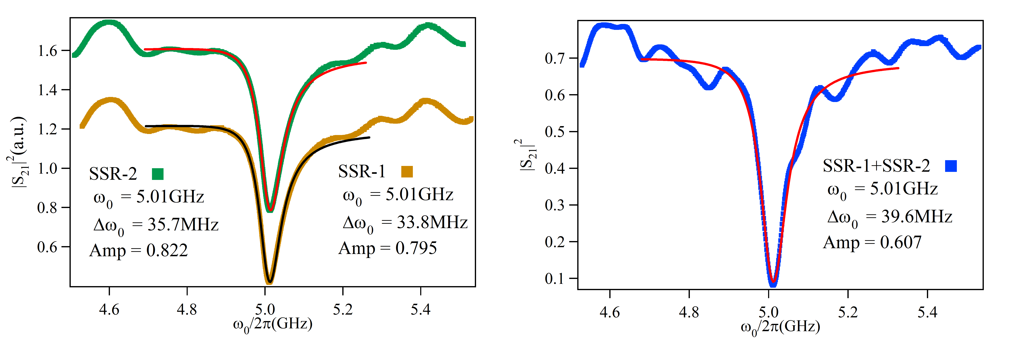

Experiment setup
VNA
$$ΔΦ$$
SSR-1
SSR-2

Slide 3
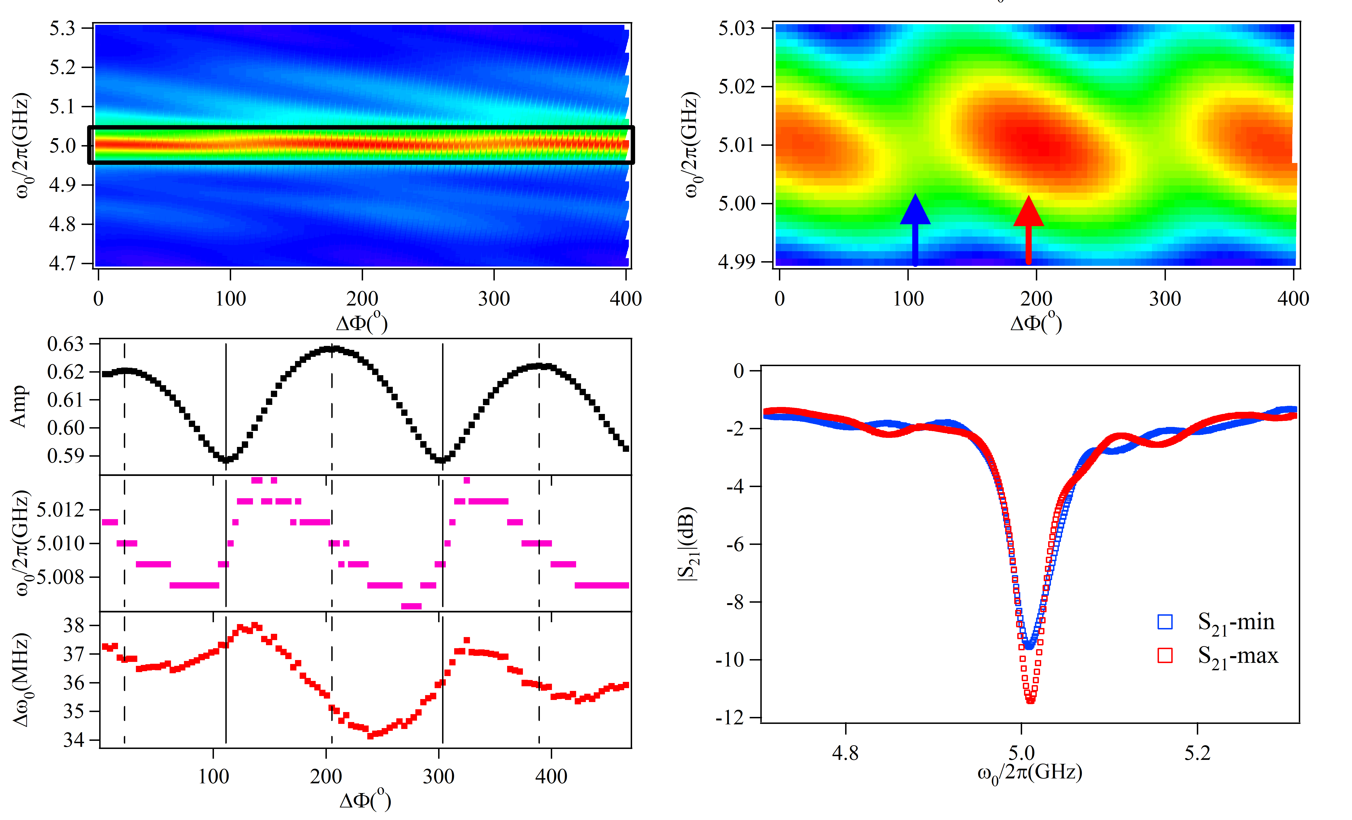



Result:
S21 mapping
Zoomed in S21
$$A$$
$$ω_{0}$$
$${Δω}_{0}$$
Fitting
S21 spectra

